Slide 1
ICAIIC
2020
UAV-assisted Real-time Data Processing
using Deep Q-Network for Industrial Internet of Things
Riesa Krisna Astuti Sakir, Muhammad Rusyadi Ramli, Jae Min Lee and Dong Seong Kim
(Kumoh National Institute of Technology, Korea (South))

Slide 2

Abstract
Industrial internet of things (IIoT) enables edge computing technology
A task scheduling is implemented in the edge node and
the real-time data can achieve with the lowest latency that allowed by the edge node near the edge network.
However a mobile machine(Autonomous Guided Vehicle(AGV), Unmanned Aerial Vehicle (UAV)) can interfere in this situation → QoS(quality of service can decrease.)
Therefore this paper deploys an UAV as an edge node to provide service to the edge network trough optimizing the trajectory of UAV, where the edge network request task using DQN learning.
Subsequently the real-time data can achieve either the interrupt occurs at the edge node.
Notes:
to provide communication between the machines that produce a large amount of data and locate at the edge network.
Overthat QoS can decrease

Slide 3
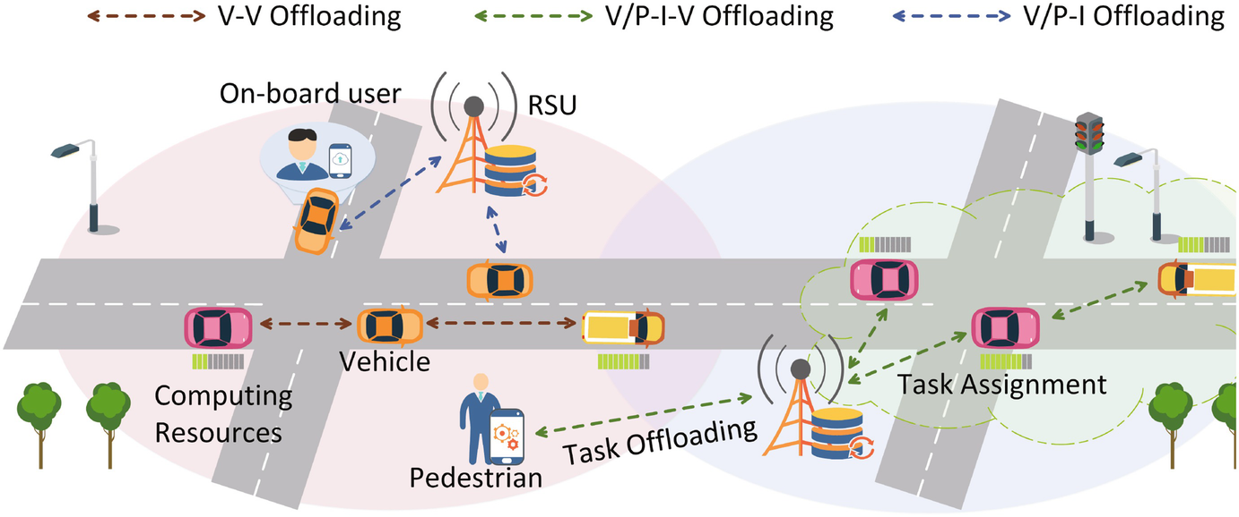
Introduction
In a smart factory, machines interconnect millions of sensors and actuators, either static or mobile devices, through the internet.
→ Enables the machines to communicate with each other
The machine is located at the edge network which has a lower capacity to compute a task. → for a mobile device (UAV, AGVehicle) has an energy limit.
Thus they need to offload a task to a computation service that near to them
A new paradigm, edge computing service that near to edge network, can provide computation with lower latency than cloud computing that far away from edge network.

Slide 4
Introduction
A massive amount of data needs to schedule for the execution procedure of the requested task regarding the timing constraint of each machine in the industrial environment.
However, data scheduling has to be concerned because it is equipped with the timing constraint to achieve real-time data.
When the scheduling process is bothered by interruption, the execution time of each task can inhibited. → decrease QoS
Such as autonomous vehicle, which is move with instruction that also needs the execution task by a near-edge node.
In real-time

Slide 5
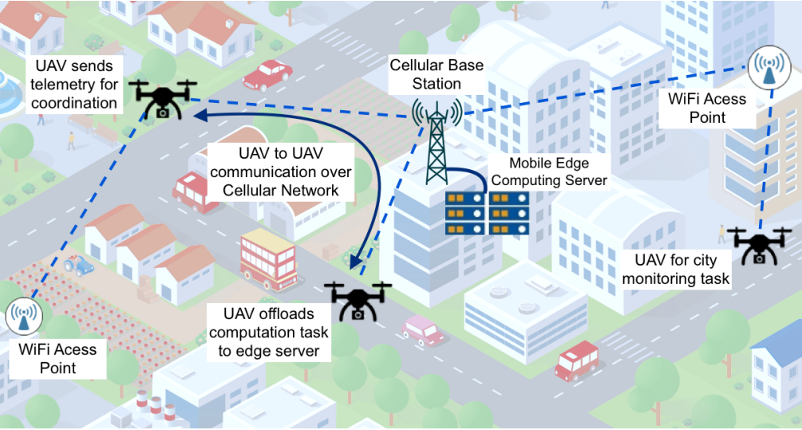
Introduction
Consider UAV within the edge computing network can act as an edge node.
A UAV can provide computation capability for edge devices offload their task.
In previous research, the optimization of connectivity constraint using cellular-enable UAV method, is slightly edge devices that can provide communication.
Therefore, the machine learning algorithm is chosen to provide communication for edge devices
briefly, the contributions of this paper as follows.
Edge computing network with UAV is provided that enables coverage communication to edge devices without interfering with the data scheduling in IIoT.
Deep Q-network (DQN) Learning for UAV is proposed, which considers the edge computing network in IIoT.

Slide 6
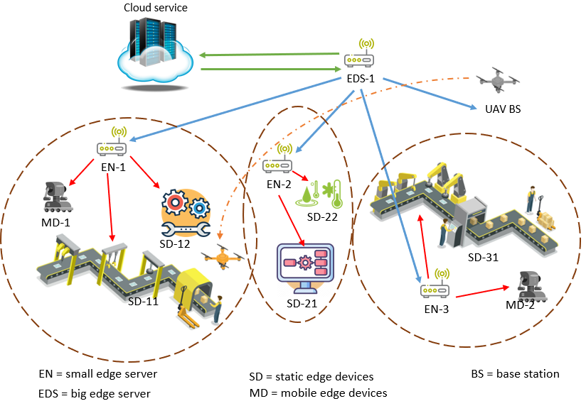
System model
Third layer
Second layer
The structure of IIoT network within layering
Edge nodes deployment aims the execution task by millions of data. I.e., devices offload tasks to the adjacency edge node.
First layer
With that condition, the static devices that bothered by mobile devices need services from another edge node, it is a UAV.
The higher edge server responsible for instructing the UAV base station that the UAV has to provide the communication to the static devices
Based on the task position and task priority, the UAV moves freely to near static devices. Then, provide communication and computation for static devices in real-time.

Slide 7
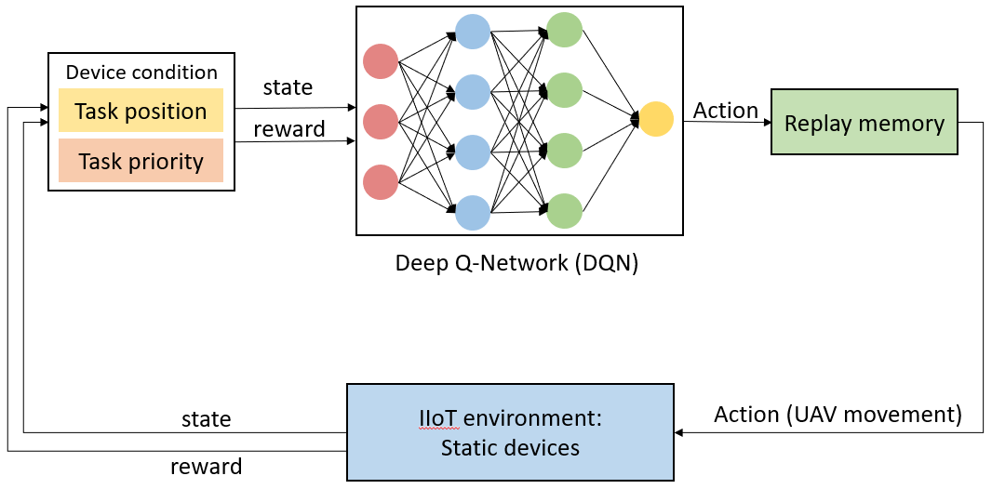
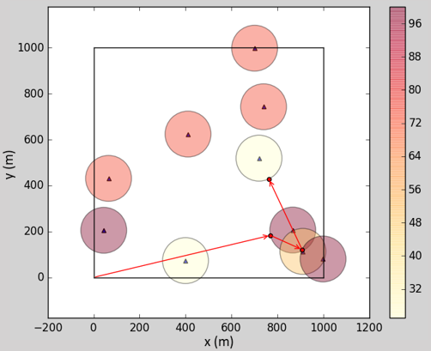
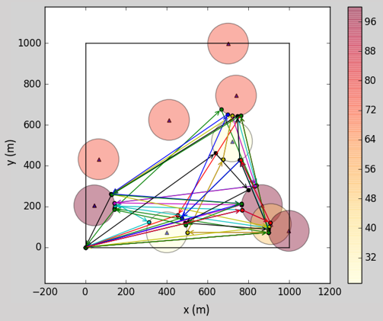
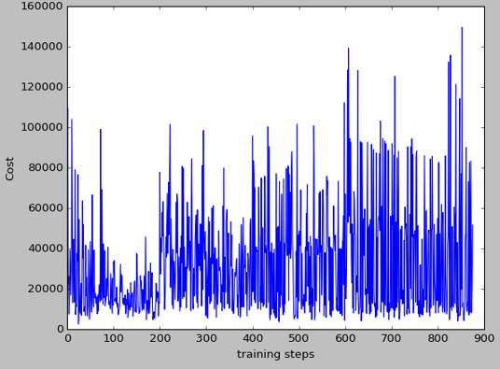
DQN-based UAV path planning
State is defined by static and mobile devices that generated the tasks, then offload it to the edge
node.
Action is the assigned of the movement of UAV.
The cumulative reward is collected to achieve the goal. ???
result
UAV-based DQN trajectory (first training)
UAV-based DQN trajectory (experience)
training step of DQN

